Slide 1
exceptions
Java Networking

Slide 2
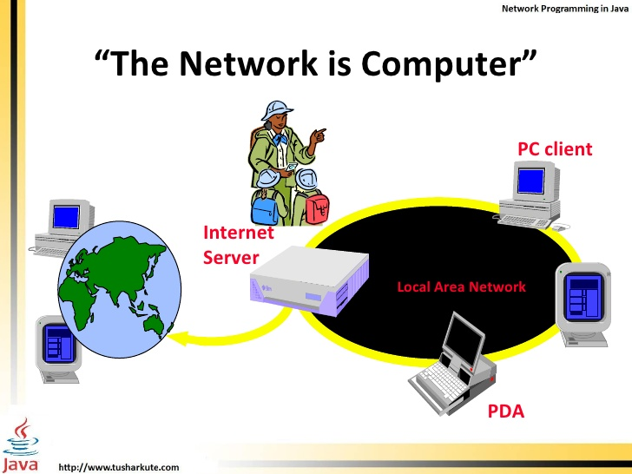

exceptions

Slide 3
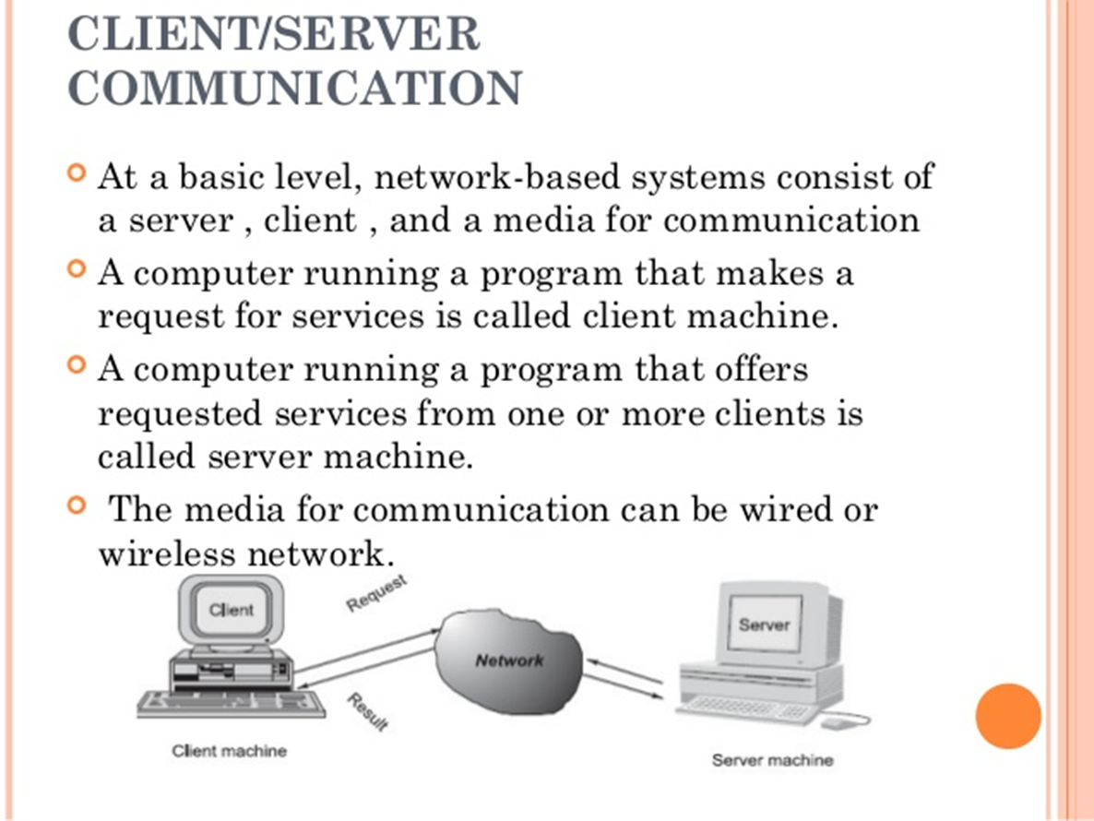
exceptions

Slide 4
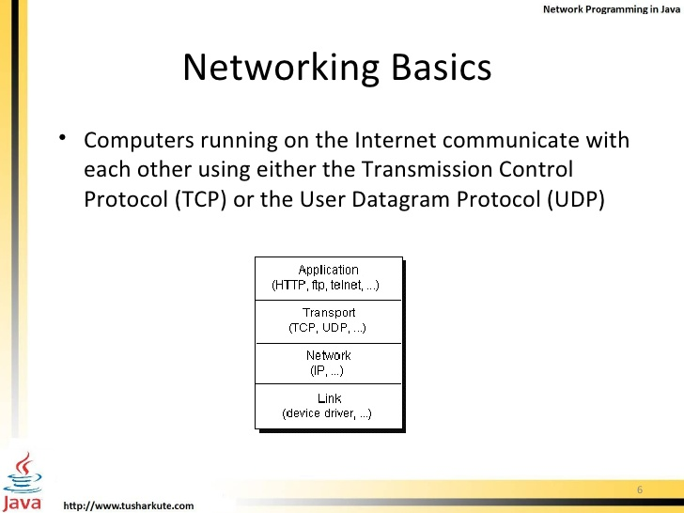
exceptions

Slide 5
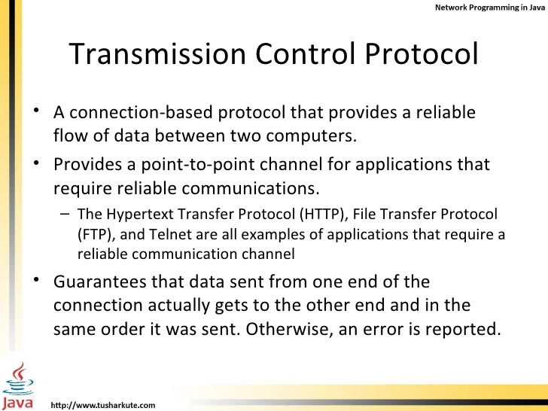
exceptions

Slide 6
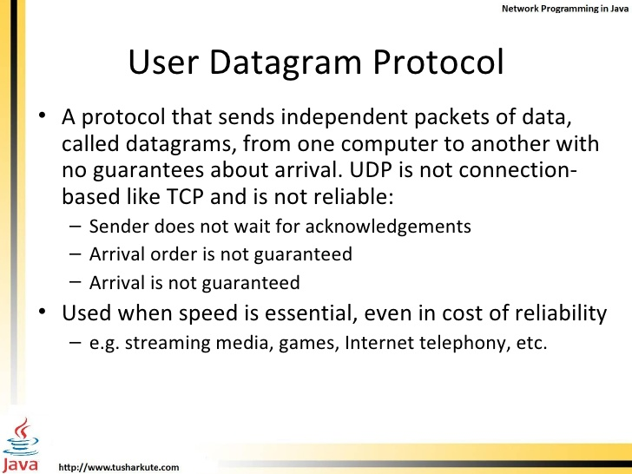
exceptions

Slide 7
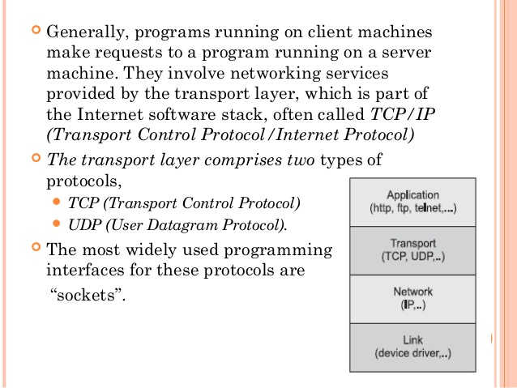
exceptions

Slide 8
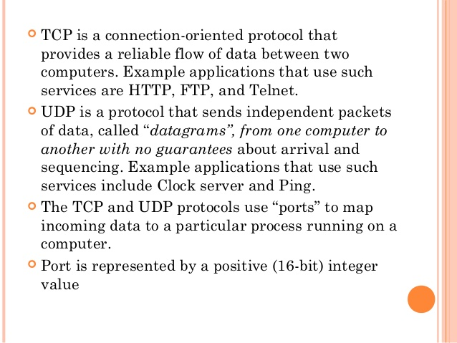
exceptions

Slide 9
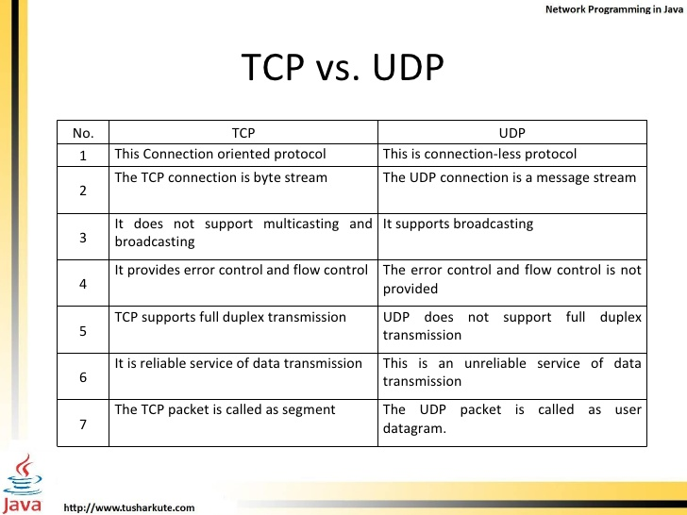
exceptions

Slide 10
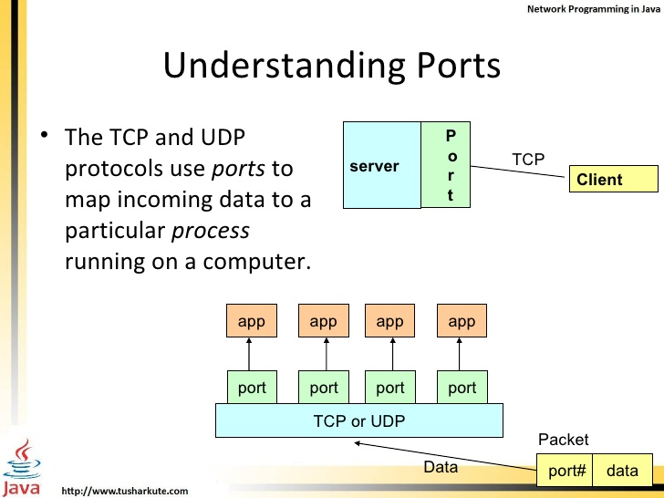
exceptions

Slide 11
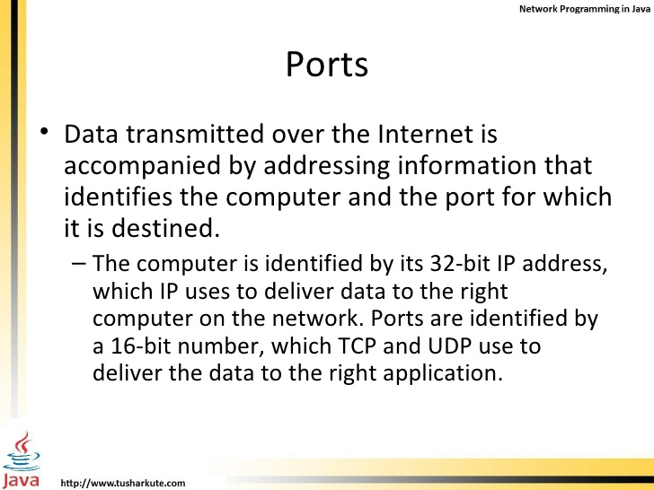
exceptions

Slide 12
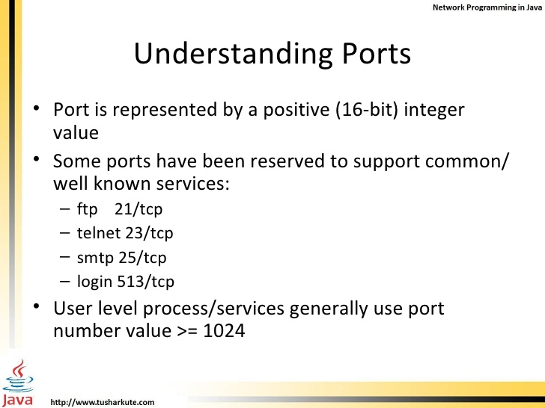
exceptions

Slide 13
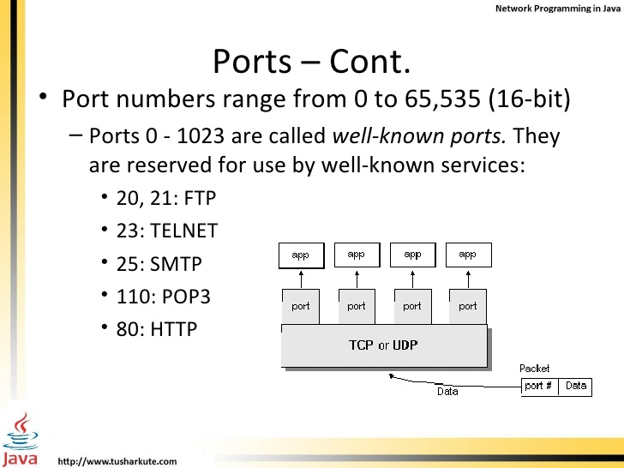
exceptions

Slide 14
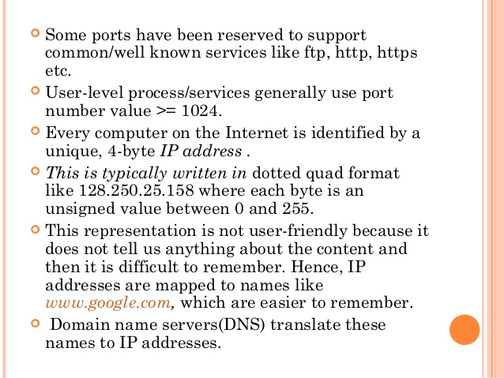
exceptions

Slide 15
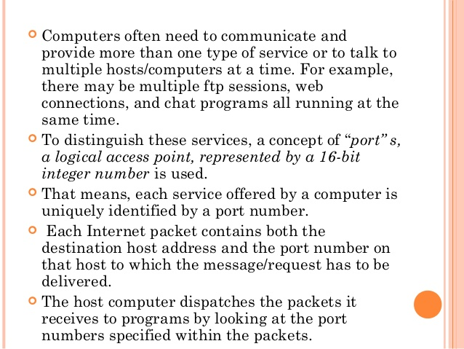
exceptions

Slide 16
exceptions

Slide 17
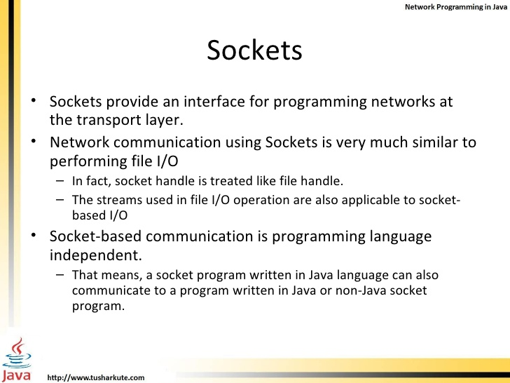
exceptions

Slide 18
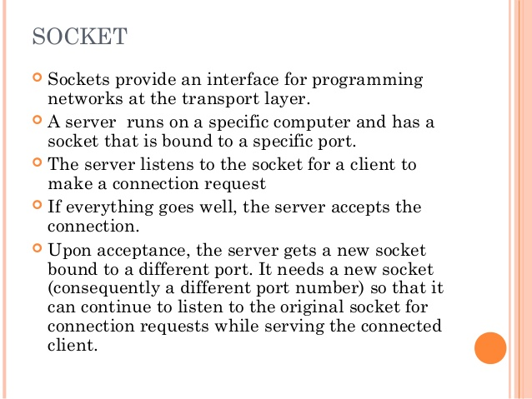
exceptions

Slide 19
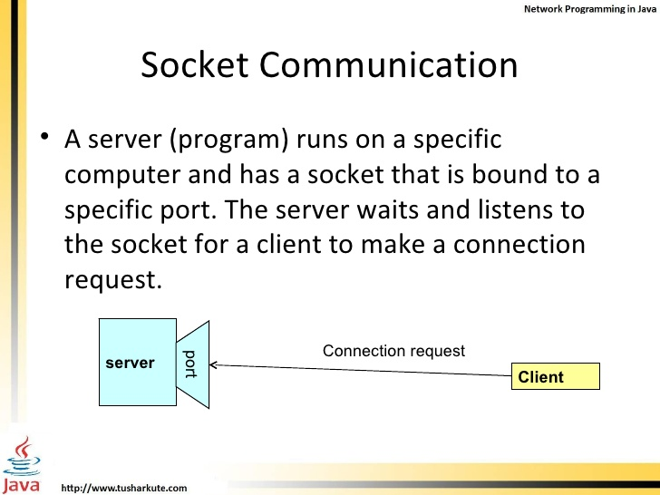
exceptions

Slide 20
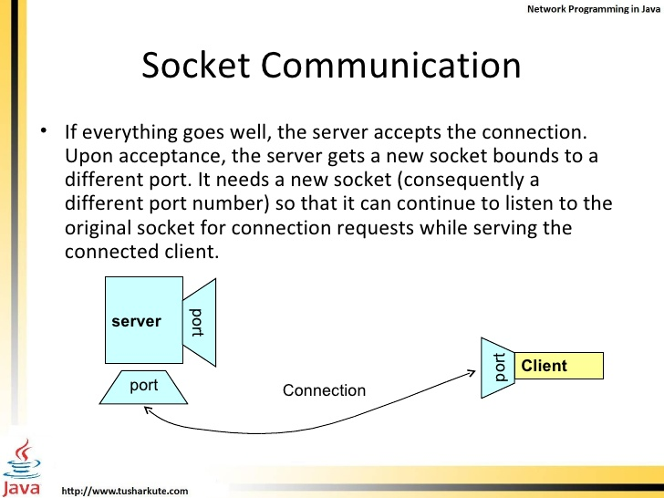
exceptions

Slide 21
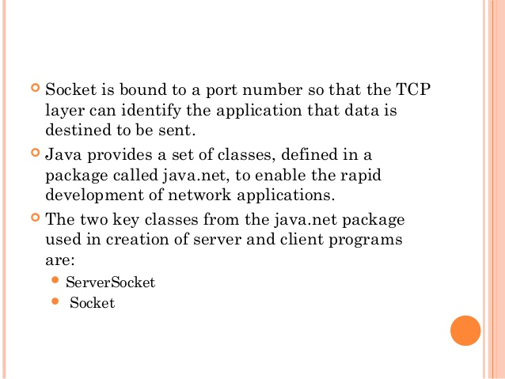
exceptions

Slide 22
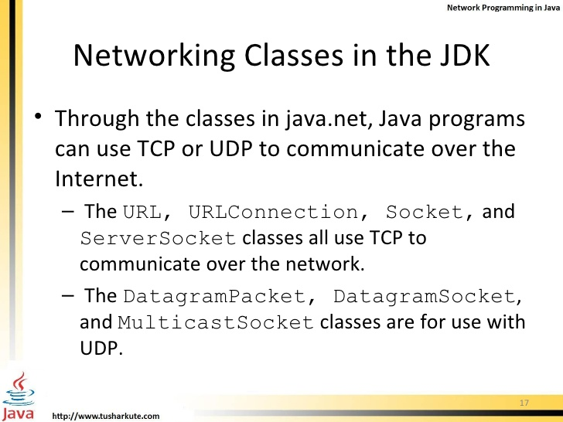
exceptions

Slide 23
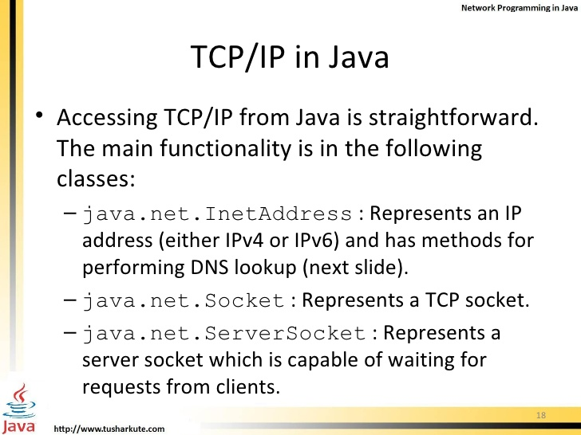
exceptions

Slide 24
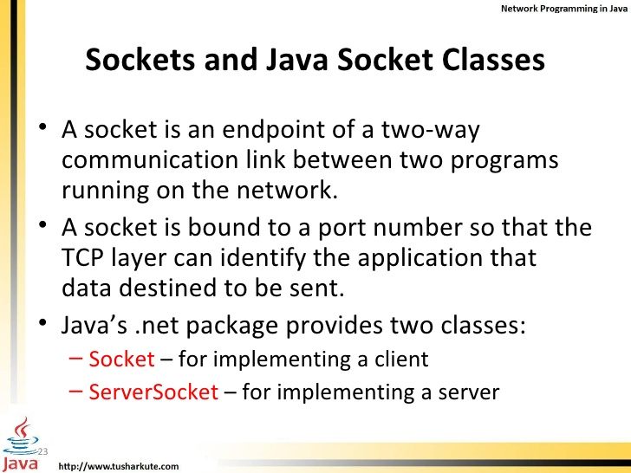
exceptions

Slide 25
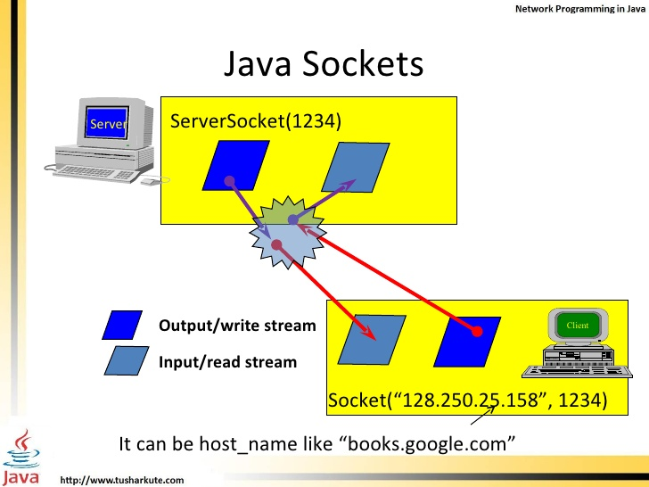
exceptions

Slide 26
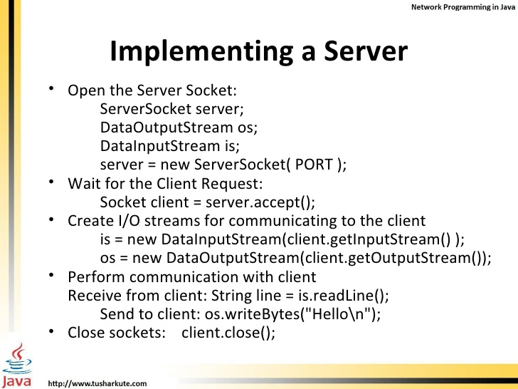
exceptions

Slide 27
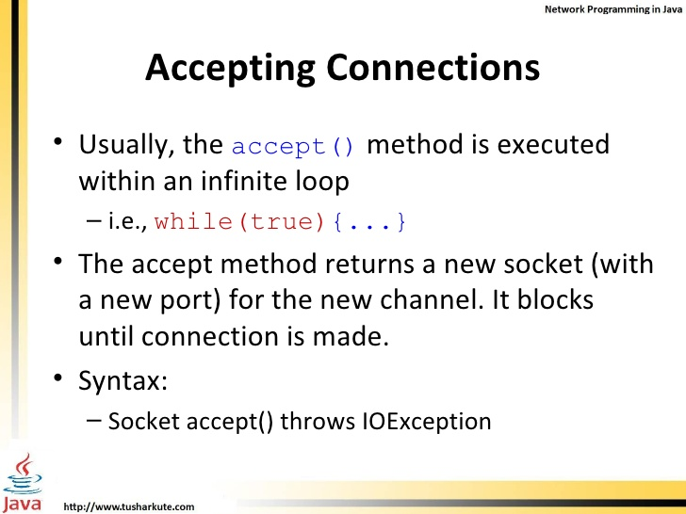
exceptions

Slide 28
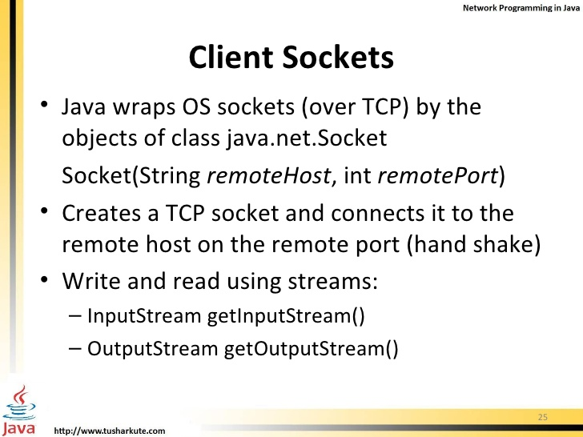
exceptions

Slide 29
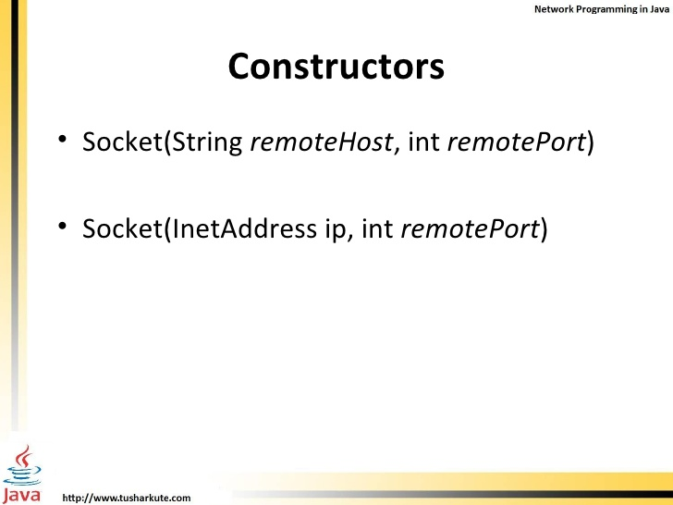
exceptions

Slide 30
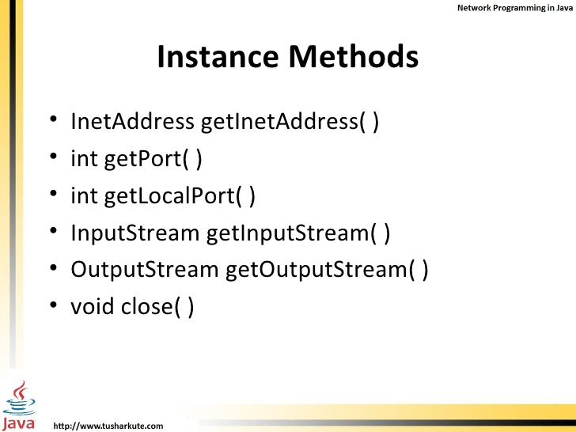
exceptions

Slide 31
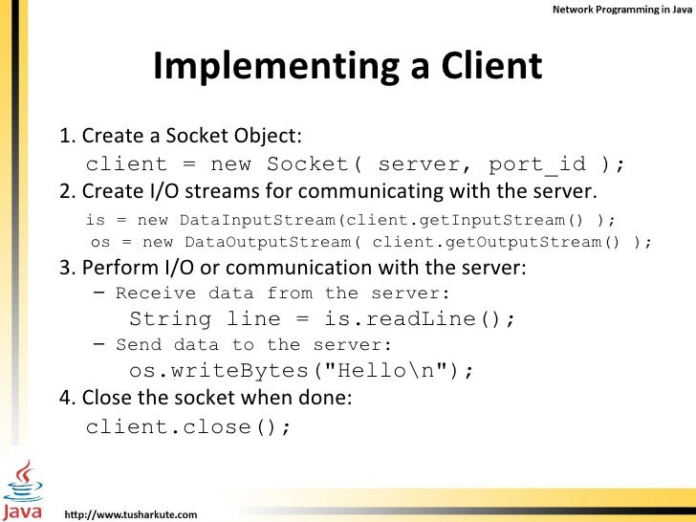

exceptions

Slide 32
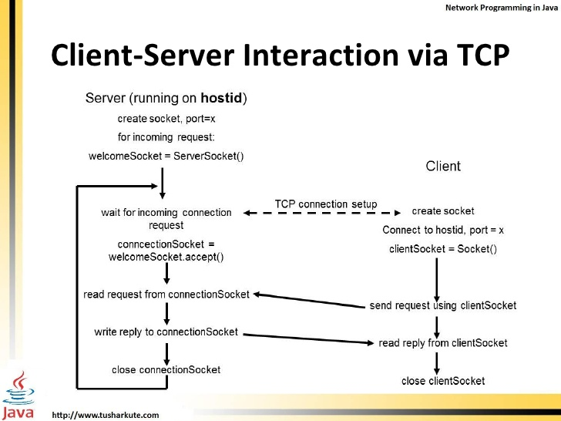
exceptions

Slide 33
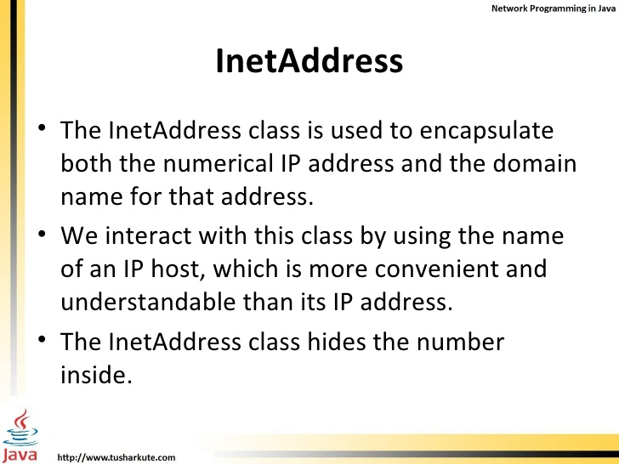
exceptions

Slide 34
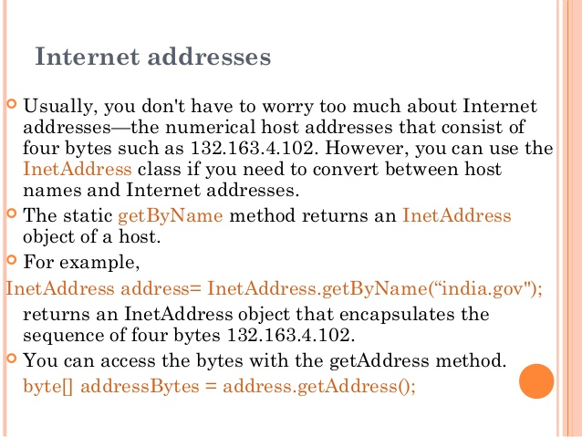
exceptions

Slide 35
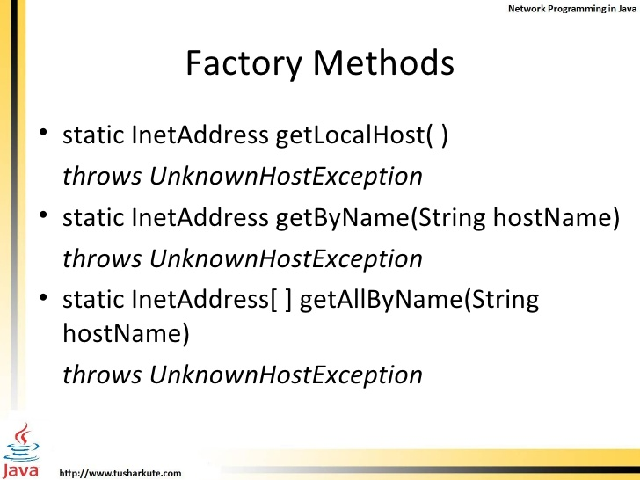
exceptions

Slide 36
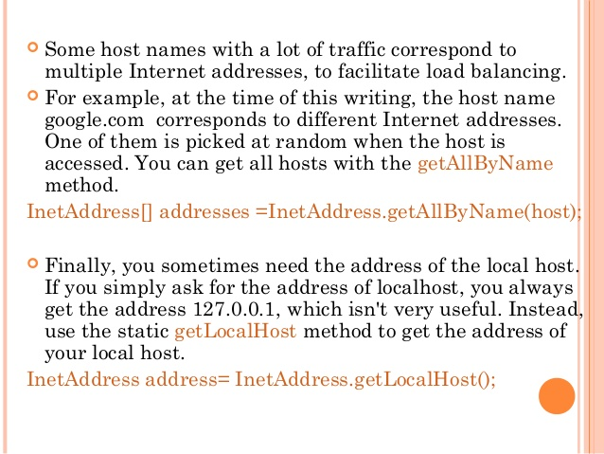
exceptions
Lab21.1: Demonstration of using InetAddress

Slide 37
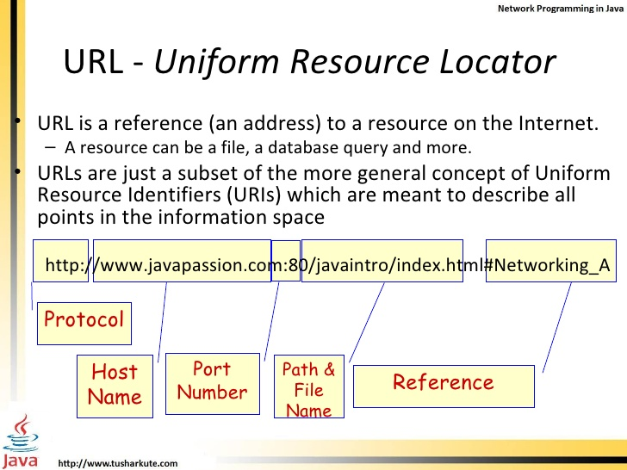
exceptions

Slide 38
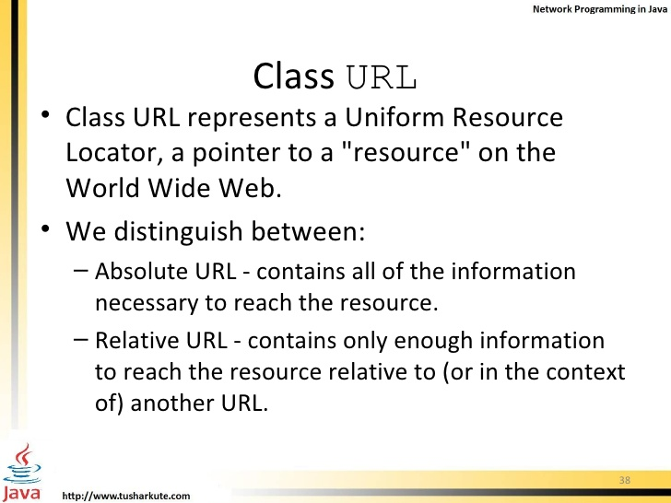
exceptions

Slide 39
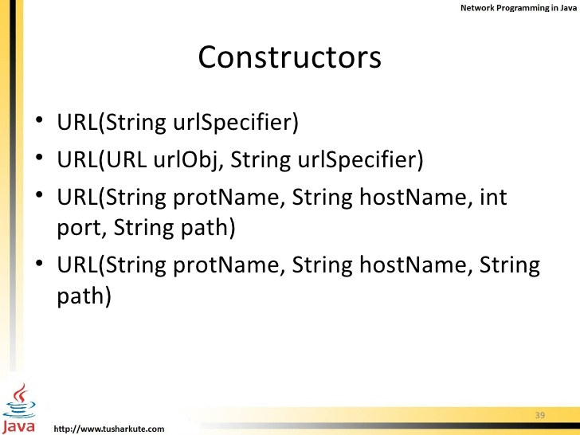
exceptions
Lab21.4: Demonstration of URL class:

Slide 40
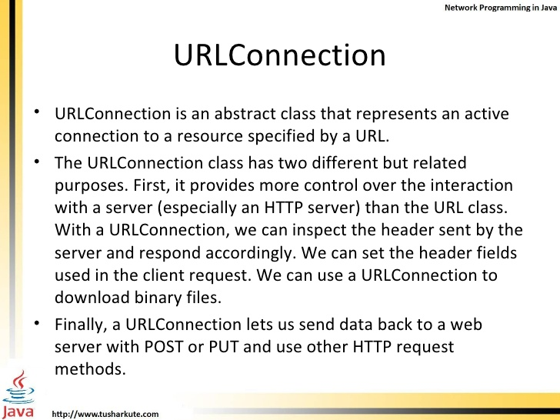
exceptions

Slide 41
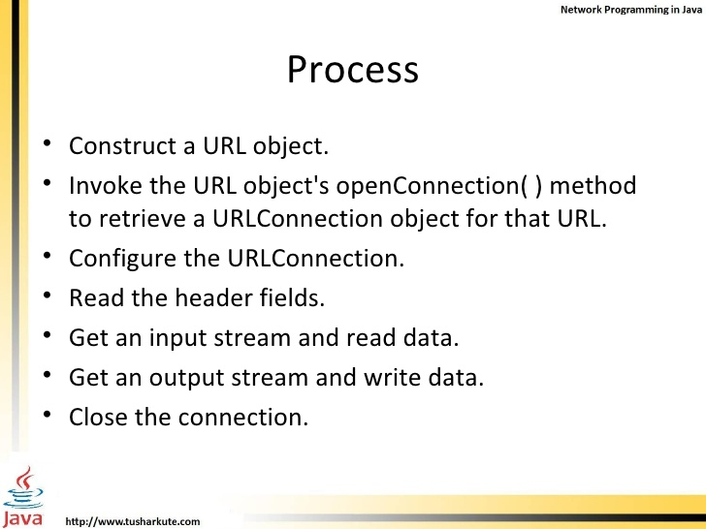
exceptions

Slide 42
exceptions
Reading from a URL
Ex:
URL oracle = new URL("http://www.oracle.com/");
URLConnection yc = oracle.openConnection();
BufferedReader in = new BufferedReader(new InputStreamReader(
yc.getInputStream()));
String inputLine;
while ((inputLine = in.readLine()) != null)
System.out.println(inputLine);
in.close();

Slide 43
exceptions
Writing to a URL
Ex:
URL url = new URL(args[0]);
URLConnection connection = url.openConnection();
connection.setDoOutput(true);
OutputStreamWriter out = new OutputStreamWriter(
connection.getOutputStream());
out.write("string=" + stringToReverse);
out.close();

Slide 44
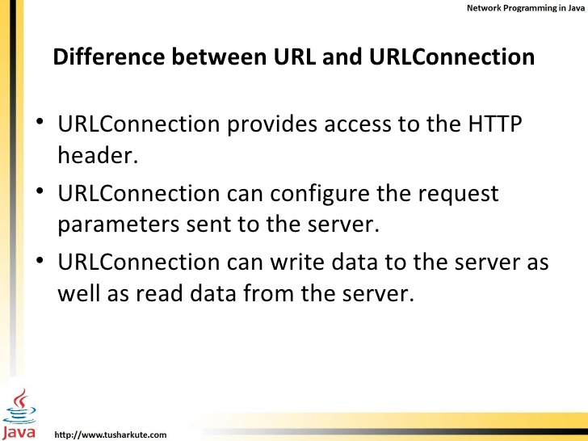
exceptions

Slide 45
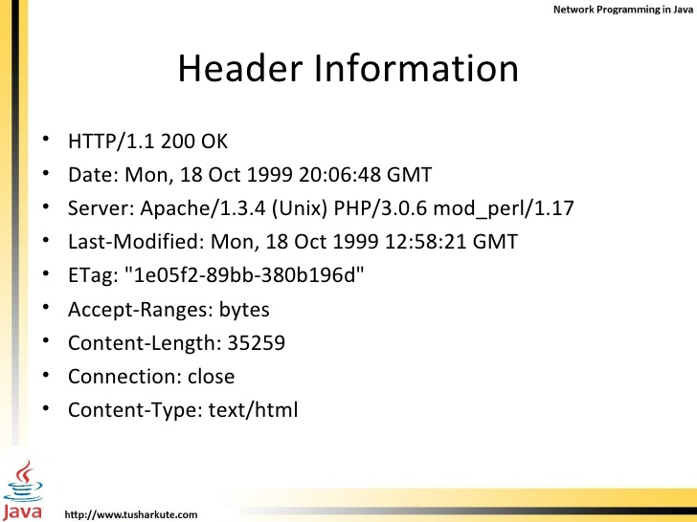
exceptions

Slide 46
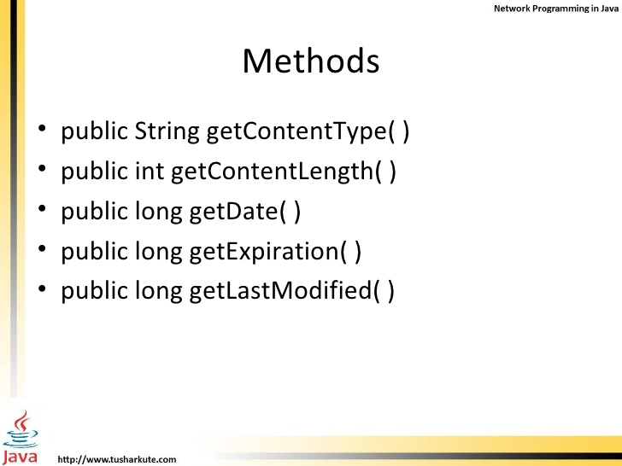
exceptions
Lab21.5: Printing header information using URLConnection

Slide 47
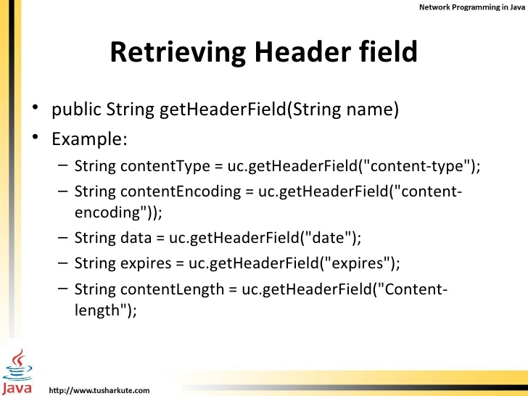
exceptions

Slide 48
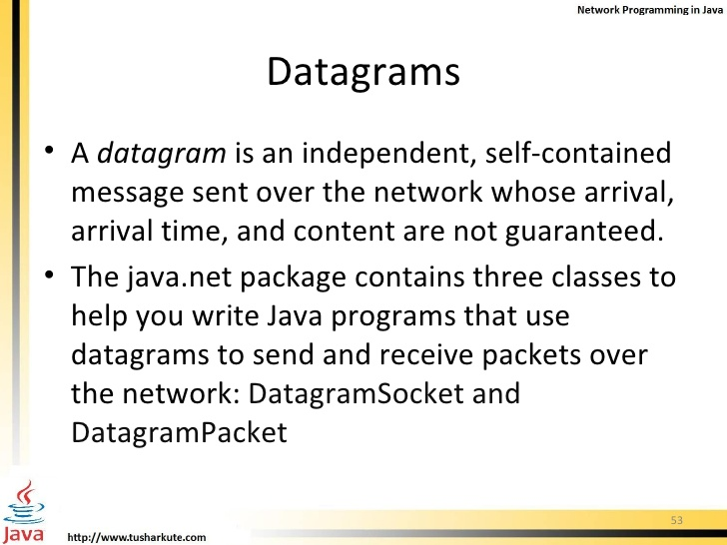
exceptions

Slide 49
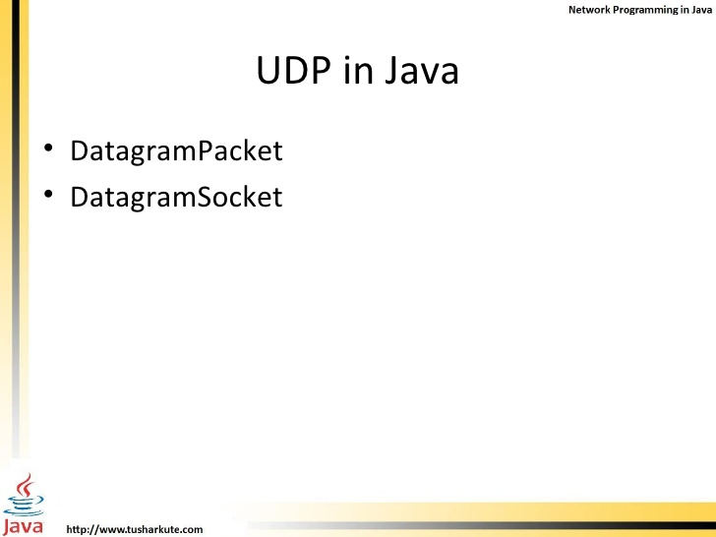
exceptions
MultiCastSocket
An application can send and receive DatagramPackets through a DatagramSocket. In addition, DatagramPackets can be broadcast to multiple recipients all listening to a MulticastSocket.

Slide 50
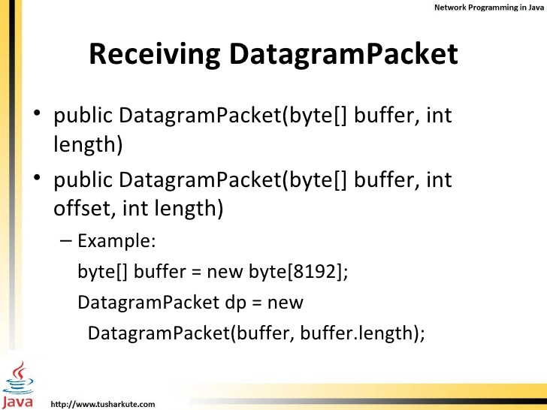
exceptions

Slide 51
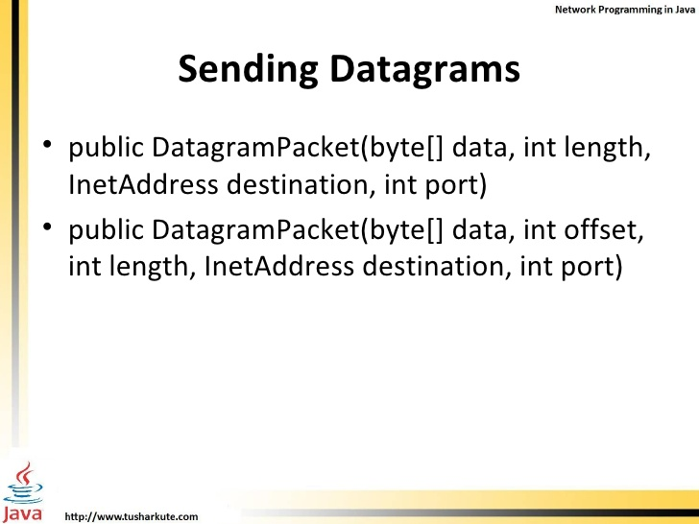
exceptions

Slide 52
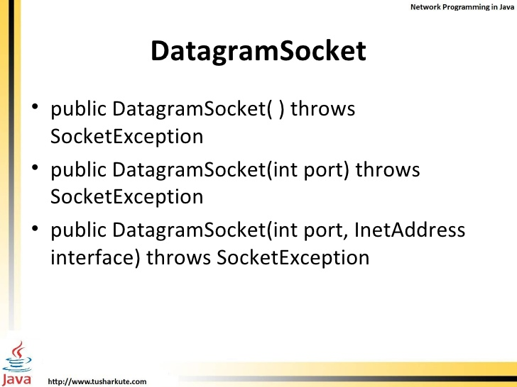
exceptions

Slide 53
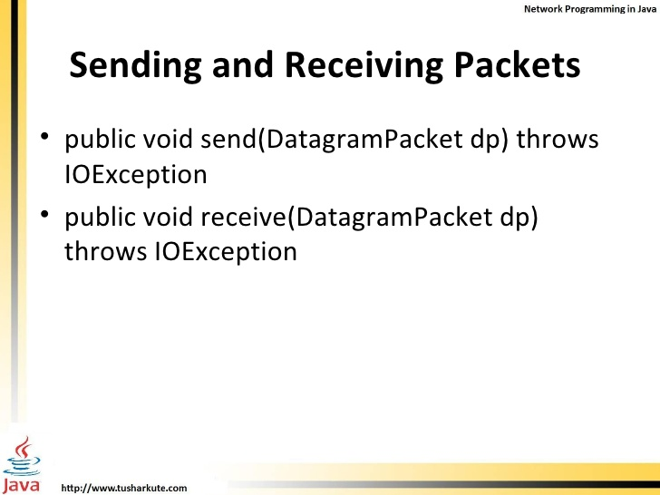
exceptions
Lab21.6: Demonstration of Datagram Client and server:
Lab21.7: Demonstration of using Datagram for broadcasting to multiple clients.

Slide 54
exceptions

Slide 55
exceptions
Running Eclipse

Slide 56
exceptions
Client/Server

Slide 57
exceptions
Running Eclipse

Slide 58
exceptions
Running Eclipse

Slide 59
exceptions

Slide 60
exceptions
Running Eclipse

Slide 61
exceptions
References:
http://www.slideshare.net/mousmip/networking-java

Slide 62
Java - miscellaneous
Type Comparison Operator instanceof
The instanceof operator compares an object to a specified type.
You can use it to test if an object is an instance of a class, an instance of a subclass, or an instance of a class that implements a particular interface
Classes implementing interfaces
class MyClass extends MySuperClass implements YourInterface {
// field, constructor, and
// method declarations
}

Slide 63
Java - miscellaneous
Varargs – Specifying Arbitrary number of arguments
public Polygon polygonFrom(Point... corners) {
int numberOfSides = corners.length;
double squareOfSide1, lengthOfSide1;
squareOfSide1 = (corners[1].x - corners[0].x)
* (corners[1].x - corners[0].x)
+ (corners[1].y - corners[0].y)
* (corners[1].y - corners[0].y);
lengthOfSide1 = Math.sqrt(squareOfSide1);
// more method body code follows that creates and returns a
// polygon connecting the Points
}
You will most commonly see varargs with the printing methods; for example, this printf method:
public PrintStream printf(String format, Object... args)
allows you to print an arbitrary number of objects. It can be called like this:
System.out.printf("%s: %d, %s%n", name, idnum, address);

Slide 64
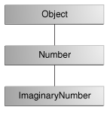
Java - miscellaneous
Returning a Class or Interface
When a method uses a class name as its return type the class of the type of the returned object must be either a subclass of, or the exact class of, the return type.
public Number returnANumber() {
...
}
The returnANumber method can return an ImaginaryNumber but not an Object. ImaginaryNumber is a Number because it's a subclass of Number. However, an Object is not necessarily a Number — it could be a String or another type

Slide 65
Advanced java
Garbage collection
JDBC
Lambda expressions
Annotations
Aggregate operations on collection using Lambarda expression.
Java streaming
Blocking queue
Aggregate operations
Autoboxing and unboxing

Slide 66
https://docs.oracle.com/javase/tutorial/reallybigindex.html
http://www.slideshare.net/EdurekaIN/java-class-3
http://www.slideshare.net/abdurrehmanabdurrehman391/variables-and-data-types-by-sir-khalid
http://www.slideshare.net/abdurrehmanabdurrehman391/java-advancedoop
http://www.slideshare.net/MindfireSolutions/java-garbage-collection-how-it-works?next_slideshow=1
http://www.slideshare.net/arnold7490/unit-4-java
http://www.slideshare.net/arnold7490/unit-3-java?next_slideshow=1
http://www.slideshare.net/tushardesarda/java-tutorial-3
http://www.slideshare.net/muralidhar9e/java-exception-handling-ppt
http://www.slideshare.net/emprovise/2-javabasics
http://www.slideshare.net/AllanHuang/java-new-evolution
http://www.slideshare.net/antonkeks/4-collections
http://www.slideshare.net/andreaiacono/java8-39841939 - Java8 features
http://www.slideshare.net/AbhishekKhune/07-java-collection
http://www.slideshare.net/shahjahan786/generics-27960064 - Generics
http://www.slideshare.net/caroljmcdonald/java-generics-2485138?next_slideshow=1

Slide 67
http://www.slideshare.net/KavitaGanesan/is-66154415-kavitaganesanv2 - Strings
http://www.slideshare.net/antonkeks/10-threads - Threads
http://www.slideshare.net/BenjDelMundo/java-thread-synchronization - Synchronization
http://www.slideshare.net/javaonkar/thread-concurrancy - Synchronization
http://www.slideshare.net/lineking/io-package - Basic IO
http://new.51cto.com – Buffered streams.
http://www.slideshare.net/EmertxeSlides/010-core-javaiofundamentals - IO
http://www.slideshare.net/martyhall/file-io-in-java-8-applying-the-power-of-streams - File IO
http://www.slideshare.net/boulderjug/55-things-in-java-7 - File IO

